Slide 1

Implementing Cross-Attention-only Time Series transformer for Commodity Prediction and Benchmarking against ARIMA and Autoformer
Koushik Selvaraj
RA2412049015105
Review 1
Date: 13-09-2025
1

Slide 2

Problem statement
Forecasting commodity prices such as crude oil, gold, and agricultural products is an inherently difficult task due to their complex, non-linear, and volatile nature, influenced by a multiple factors. Traditional statistical models like ARIMA (Auto-Regressive Integrated Moving Average) have long been favored for their simplicity and interpretability,
but they fundamentally rely on linear assumptions, which limit their ability to model non-linear dependencies and perform well in long-term horizon forecasting.
On the other hand, Transformer-based architectures have demonstrated superior performance in sequence modeling tasks by capturing long-range temporal dependencies. However, they still face limitations in time series settings due to the use of self-attention, which is permutation-invariant and reduces the ability to preserve temporal ordering effectively.

Slide 3
Problem statement
This research aims to address these challenges by introducing and evaluating the Cross-Attention-only Transformer for Time Series forecasting (CATS), which replaces self-attention with cross-attention to better capture long-range dependencies while reducing model complexity and memory usage.
The primary objective is to benchmark CATS against classical ARIMA models and contemporary advanced models like Informer and Autoformer, specifically in the context of commodity price forecasting.

Slide 4
Literature Survey
S.No | Author name | Year | Methodology used | Issues identified | Performance metrics
1 | Dongbin Kim et al. | 2024 | CATS (Cross-Attention-only Transformer); replaces self-attention with cross-attention, horizon-dependent learnable queries, parameter sharing, query-adaptive masking https://neurips.cc/virtual/2024/poster/94012 | Self-attention induces temporal information loss; excessive parameter/memory growth for long horizons; prior Transformer designs not efficient for LTSF | Lowest MSE/MAE across ETT, Electricity, Weather, Traffic; superior memory/parameter efficiency for long inputs https://neurips.cc/virtual/2024/poster/94012
2 | Zeng et al. | 2023 | DLinear (pure linear model for time series) https://openreview.net/forum?id=iN43sJoib7 | Transfomers may not outperform linear models on some datasets; complexity vs gain trade-off | Comparable or better accuracy vs advanced Transformers (PatchTST, Timesnet) on benchmarks https://openreview.net/forum?id=iN43sJoib7
3 | Wu et al. | 2023 | PatchTST (channel-independent patching in Transformers) cf66f995883298c4db2f0dcba28fb211-Paper-Conference.pdf | Channel-mixing and self-attention can cause accuracy drop for very long horizons | Improved short-term accuracy, competitive long-term accuracy, but memory growth issues

Slide 5
Literature Survey
S.No | Author name | Year | Methodology used | Issues identified | Performance metrics
4 | Wang et al. | 2024 | TimeMixer (pure MLP-based multi-scale mixing) https://openreview.net/forum?id=iN43sJoib7 | Linear models challenge Transformer dominance; mixing strategies impact performance | State-of-the-art multivariate forecasting for long/short horizons; high efficiency https://openreview.net/forum?id=iN43sJoib7
5 | Jinseong Park et al. | 2024 | iTransformer (variable-as-token approach for multivariate series) https://openreview.net/forum?id=iN43sJoib7 | Multi-variate forecasting can suffer from variable dependence modeling | Strong performance in multivariate, flexible feature mixing https://openreview.net/forum?id=iN43sJoib7
6 | Traditional/Box-Jenkins | ~1970-2024 | ARIMA (Auto-Regressive Integrated Moving Average model) https://www.investopedia.com/terms/a/autoregressive-integrated-moving-average-arima.asp | Limited to stationary, linear dynamics; accuracy falls in non-linear/long-term settings | Robust for short-term/linear signals; performance degrades on non-stationary or long-term, high volatility series autoregressive-integrated-moving-average-arima.asp

Slide 6
2.Novelty Justification
Novelty Elements
Removes All Self-Attention: CATS eliminates self-attention entirely, which traditional Transformers rely on for temporal modeling.
Pure Cross-Attention Mechanism: Instead of mixed or encoder-only attention, CATS uses horizon-dependent queries (forecast targets) and treats past data as keys/values in a dedicated cross-attention design.
Parameter Sharing and Adaptive Masking: The model introduces future-specific parameter sharing and query-adaptive masking, which improves efficiency and accuracy for long-horizon predictions
Empirical Evidence: Across multiple benchmark datasets, CATS achieves lower MSE/MAE and shows consistent memory and parameter efficiency, surpassing both classical models (ARIMA) and advanced Transformers (PatchTST, TimeMixer, DLinear) in long-term commodity forecasting tasks

Slide 7
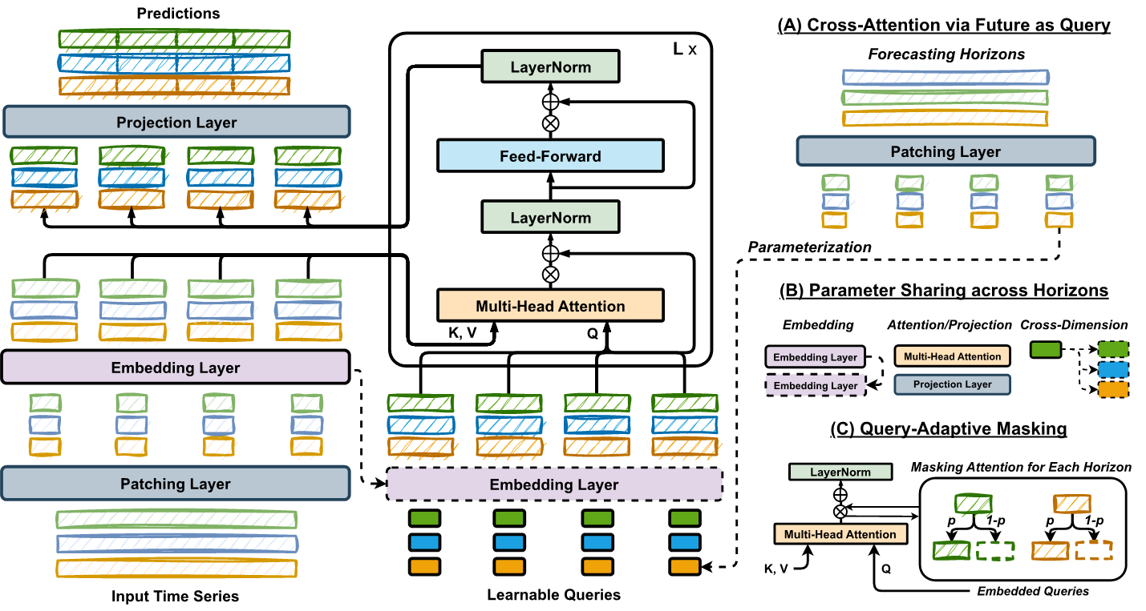
3. Architecture design

Slide 8
Expected outcomes
The four expected outcomes for research evaluating the Cross-Attention-only Transformer (CATS) alongside ARIMA and advanced Transformer models in commodity price forecasting are:
1. Improved Long-Term Forecasting Accuracy
CATS is anticipated to outperform both classical ARIMA models and leading Transformer-based models like PatchTST, TimeMixer, and DLinear on long-horizon forecasting tasks, especially in capturing non-linear and periodic patterns in commodity price data.
2. Greater Parameter and Memory Efficiency
3. Benchmarking and Critical Insights
Extensive empirical benchmarking will establish whether self-attention is necessary or even optimal for time series forecasting.

Slide 9
References
Original Paper: https://arxiv.org/abs/2405.16877
NeurIPS 2024 https://neurips.cc/media/neurips-2024/Slides/94012.pdf

